Slide 1

Project Management: Achieving Competitive Advantage
Fifth Edition
Chapter 1
Introduction: Why Project Management?
Copyright © 2019, 2016, 2013 Pearson Education, Inc. All Rights Reserved
Notes:
If this PowerPoint presentation contains mathematical equations, you may need to check that your computer has the following installed:
1) MathType Plugin
2) Math Player (free versions available)
3) NVDA Reader (free versions available)

Slide 2
Learning Objectives (1 of 2)
1.1 Understand why project management is becoming such a powerful and popular practice in business.
1.2 Recognize the basic properties of projects, including their definition.
1.3 Understand why effective project management is such a challenge.
1.4 Understand and explain the project life cycle, its stages, and the activities that typically occur at each stage in the project.

Slide 3
Learning Objectives (2 of 2)
1.5 Understand the concept of project “success,” including various definitions of success, as well as the alternative models of success.
1.6 Understand the purpose of project management maturity models and the process of benchmarking in organizations.
1.7 Recognize how mastery of the discipline of project management enhances critical employability skills for university graduates.

Slide 4
P M B o K Core Concepts
Project Management Body of Knowledge (P M B o K) covered in this chapter includes:
Definition of a Project (P M B o K 1.2)
Definition of Project Management (P M B o K 1.3)
Relationship to Other Management Disciplines (P M B o K 1.4)
Project Phases and the Project Life Cycle (P M B o K 2.1)

Slide 5
What Is a Project?
Projects are complex, one-time processes.
Projects are limited by budget, schedule, and resources.
Projects are developed to resolve a clear goal or set of goals.
Projects are customer-focused.
A project is a temporary endeavor undertaken to create a unique product, service, or result.
P M B o K 5th edition

Slide 6
General Project Characteristics (1 of 2)
Projects are ad hoc endeavors with a clear life cycle.
Projects are building blocks in the design and execution of organizational strategies.
Projects are responsible for the newest and most improved products, services, and organizational processes.
Projects provide a philosophy and strategy for the management of change.
Project management entails crossing functional and organizational boundaries.

Slide 7
General Project Characteristics (2 of 2)
Traditional management functions of planning, organizing, motivation, directing, and controlling apply to project management.
Principal outcomes of a project are the satisfaction of customer requirements within the constraints of technical, cost, and schedule objectives.
Projects are terminated upon successful completion of performance objectives.

Slide 8
Process and Project Management
Table 1.1 Differences Between Process and Project Management
Process | Project
Repeat process or product | New process or product
Several objectives | One objective
Ongoing | One-shot-limited life
People are homogenous | More heterogeneous
Well-established systems | Integrated system efforts
Greater certainty | Greater uncertainty
Part of line organization | Outside of line organization
Established practices | Violates established practice
Supports status quo | Upsets status quo

Slide 9
Project Success Rates
Software and hardware projects fail at a 65% rate.
Over half of all I T projects become runaways.
Only 30% of technology-based projects and programs are a success.
Ten major government contracts have over $16 billion in cost overruns and are a combined 38 years behind schedule.
One out of six I T projects has an average cost overrun of 200% and a schedule overrun of 70%.
More than one-third of the $110 billion in costs spent on the post-war reconstruction projects in Afghanistan, total $110 billion was lost due to fraud, waste, and abuse.

Slide 10
Why Are Projects Important?
Shortened product life cycles
Narrow product launch windows
Increasingly complex and technical products
Emergence of global markets
An economic period marked by low inflation

Slide 11
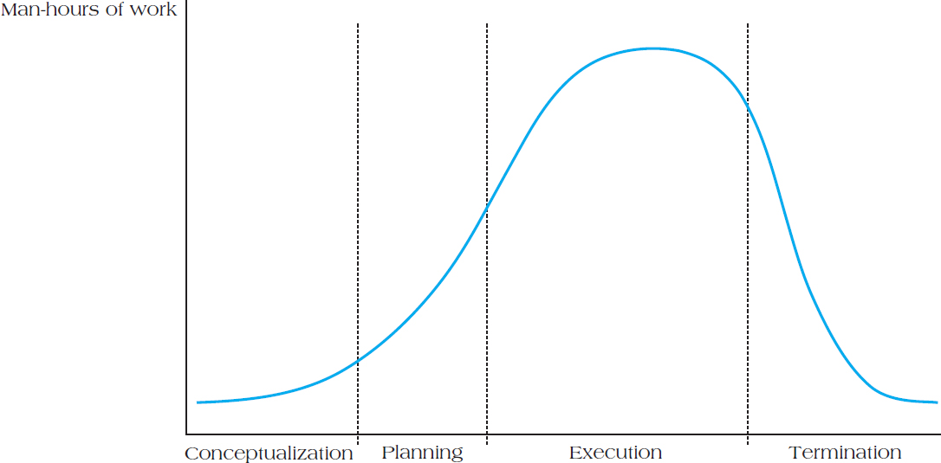
Figure 1.4 Project Life Cycle Stages

Slide 12
Project Life Cycles
A project life cycle refers to the stages in a project’s development and are divided into four distinct phases:
Conceptualization—development of the initial goal and technical specifications of the project. Key stakeholders are identified and signed on at this phase.
Planning—all detailed specifications, schedules, schematics, and plans are developed.
Execution—the actual “work” of the project is performed.
Termination—project is transferred to the customer, resources reassigned, project is closed out.

Slide 13
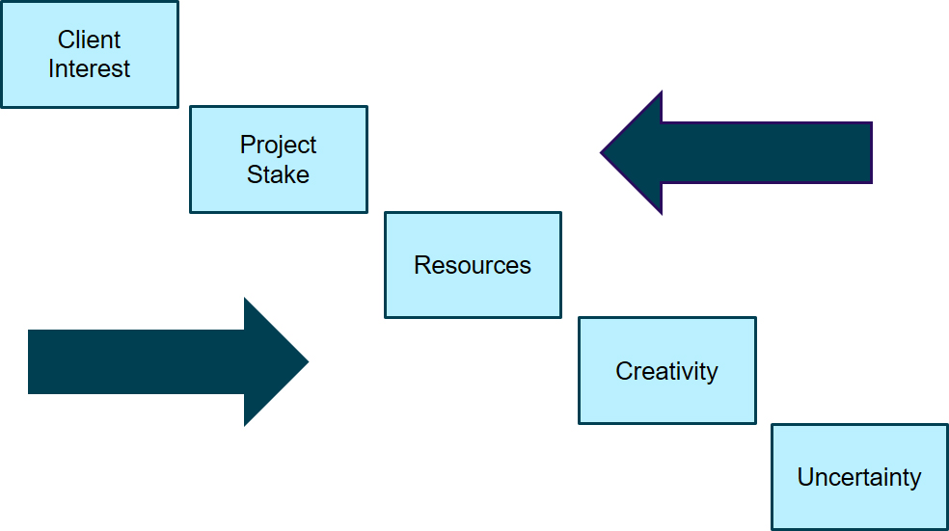
Change During Project Life Cycle

Slide 14
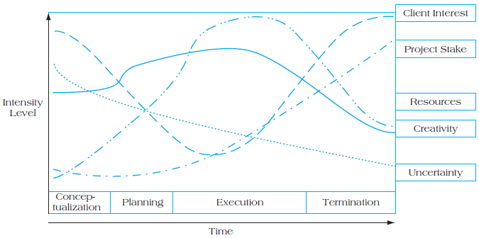
Figure 1.5 Project Life Cycles and Their Effects

Slide 15
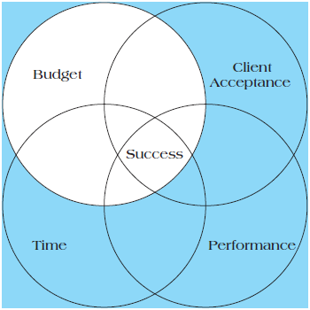
Quadruple Constraint of Project Success
Figure 1.7 The New Quadruple Constraint

Slide 16
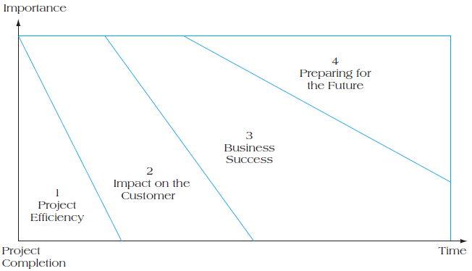
Figure 1.8 Four Dimensions of Project Success Importance

Slide 17
Table 1.2 Understanding Success Criteria
Iron Triangle | Information System | Benefits (Organization) | Benefits (Stakeholders)
Cost | Maintainability | Improved efficiency | Satisfied users
Quality | Reliability | Improved effectiveness | Social and environmental impact
Time | Validity | Increased profits | Personal development
Blank | Information quality | Strategic goals | Professional learning, contractors’ profits
Blank | Use | Organization learning | Capital suppliers, content
Blank | Blank | Reduced waste | Project team, economic impact to surrounding community

Slide 18
Six Criteria for IT Project Success
System Quality
Information Quality
Use
User Satisfaction
Individual Impact
Organizational Impact

Slide 19
Project Management Employability Skills
Communication
Critical Thinking
Collaboration
Knowledge Application and Analysis
Business Ethics and Social Responsibility
Information Technology Application and Computing Skills
Data Literacy

Slide 20
Project Manager Responsibilities
Selecting a team
Developing project objectives and a plan for execution
Performing risk management activities
Cost estimating and budgeting
Scheduling
Managing resources

Slide 21
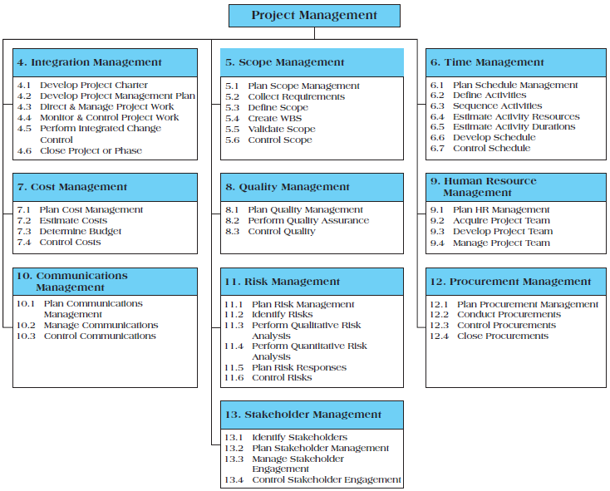
Figure 1.13 Overview of the Project Management Institute’s P M B o K Knowledge Areas

Slide 22
Summary (1 of 2)
Understand why project management is becoming such a powerful and popular practice in business.
Recognize the basic properties of projects, including their definition.
Understand why effective project management is such a challenge.
Understand and explain the project life cycle, its stages, and the activities that typically occur at each stage in the project.

Slide 23
Summary (2 of 2)
Understand the concept of project “success,” including various definitions of success, as well as the alternative models of success.
Understand the purpose of project management maturity models and the process of benchmarking in organizations.
Recognize how mastery of the discipline of project management enhances critical employability skills for university graduates.

Slide 24
THANK YOU

